Slide 1
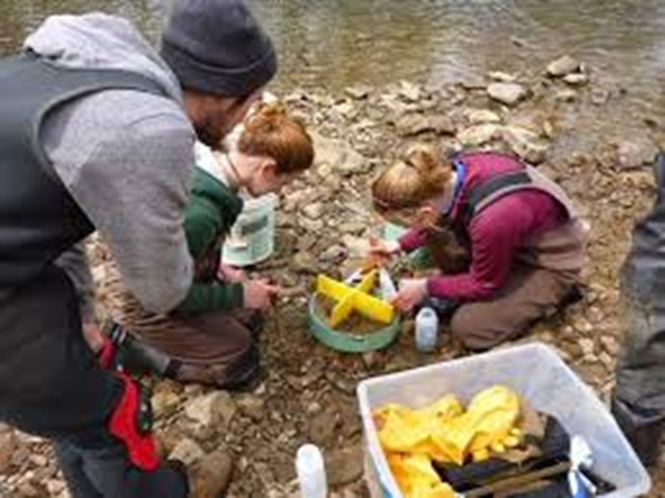
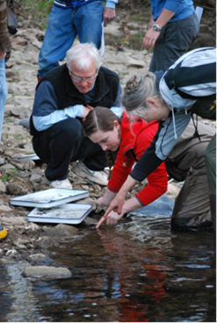



Data Visualization Tools - Data Studio

Slide 2
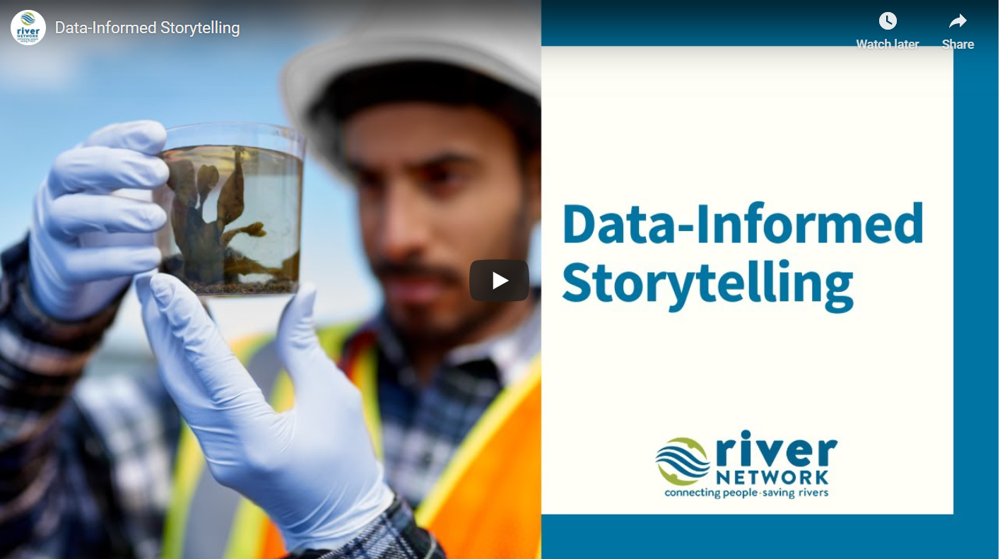


Data Products and Visualization Tools
https://www.rivernetwork.org/connect-learn/resources/effective-data-webinars/
Past Webinars
List of data products and visualization tools offered

Slide 3
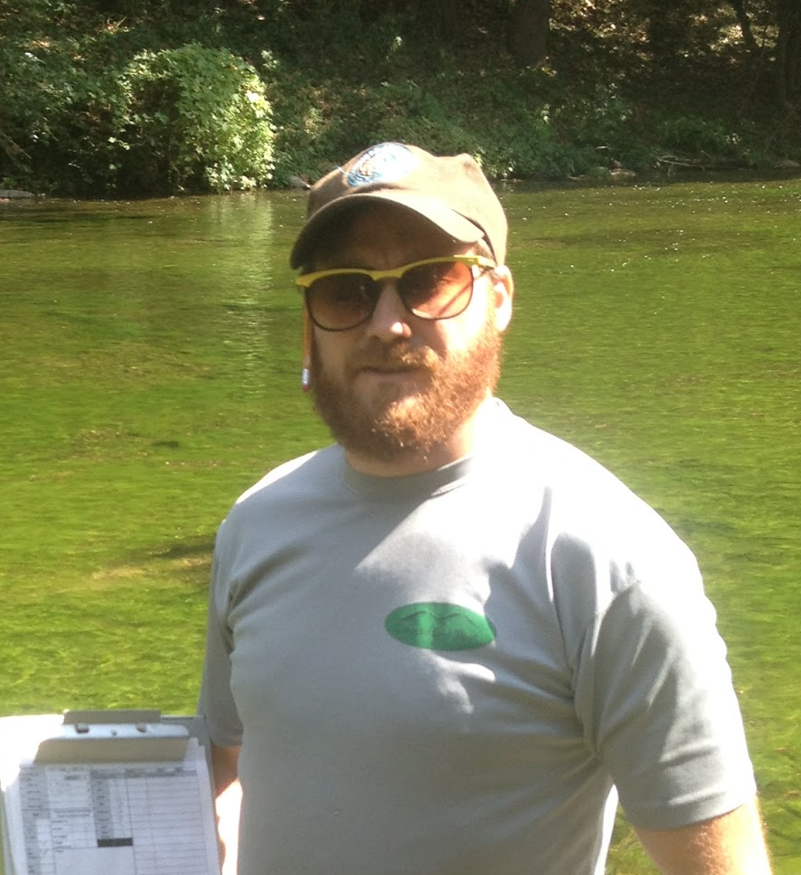
Today’s Agenda
Data Visualization Tools
What is Data Studio and how can it help me?
Getting Started
Creating a Data Source
Building a Report
Publish and Share
Demo time
Final Q&A Wrap-up
Adam Griggs
Science Manager
River Network
agriggs@rivernetwork.org

Slide 4
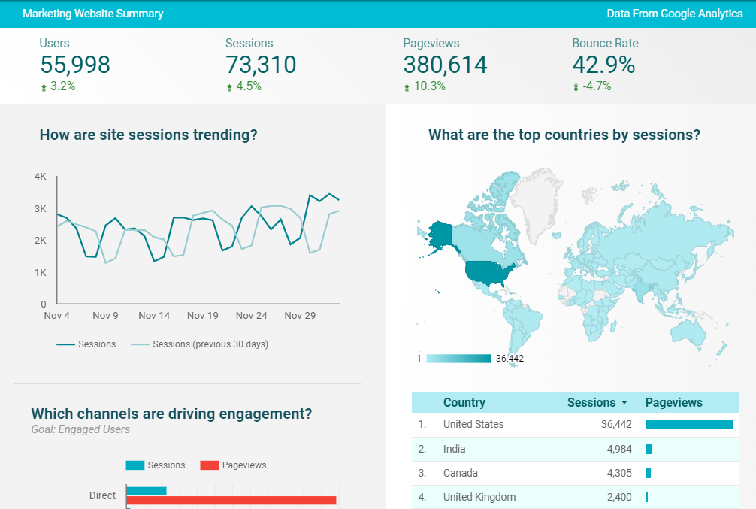
What is Google Data Studio?
DS is a Google data visualization tool, free for use and available through your browser.
“Live” data
Data dashboards
Mapping
Charts
Add images and media
Embeddable on your website

Slide 5
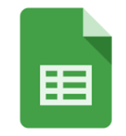
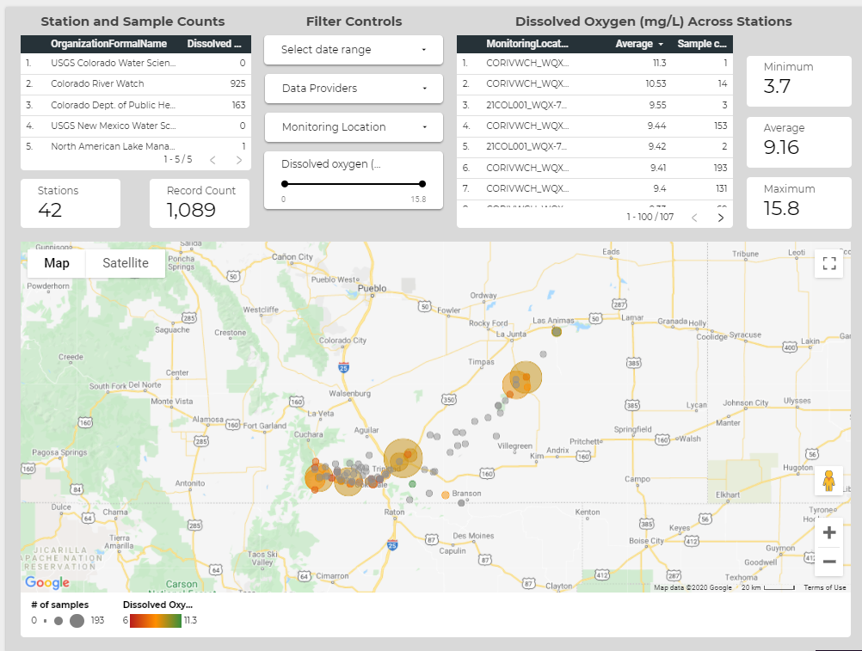
How does it work?
1 2 3
Create a data source → Build report → Publish and share

Slide 6
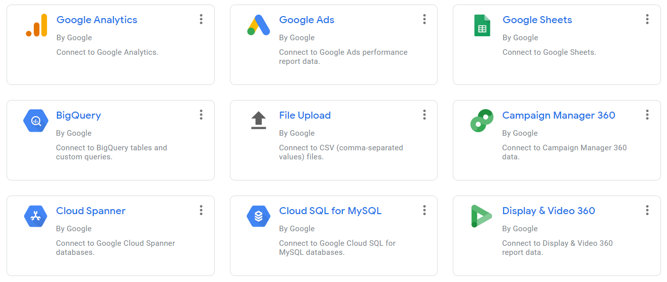
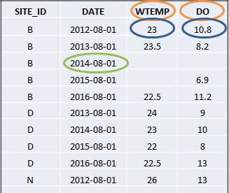
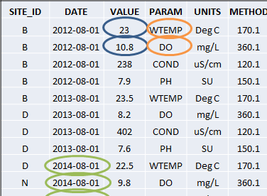
Step 1: Create a Data Source
DS can connect to numerous data sources… easiest being Google Sheets.
Data will need to be organized in a standardized format
“Matrix”, “flat”, “tidy” (DWRI)
“Stacked” (WQX)
Poll 1: How is your data currently stored?

Slide 7
Step 2: Build a Report
Give some thought to the type of report you want to build:
Data Discovery app: What data is available?
Story of a pollutant: Chlorides across the watershed
Station deep dive: What’s happening at this location?
Scorecard: Rolled up data ready for non-science audiences
Data Explorer: Robust app to help you ask and answer questions

Slide 8

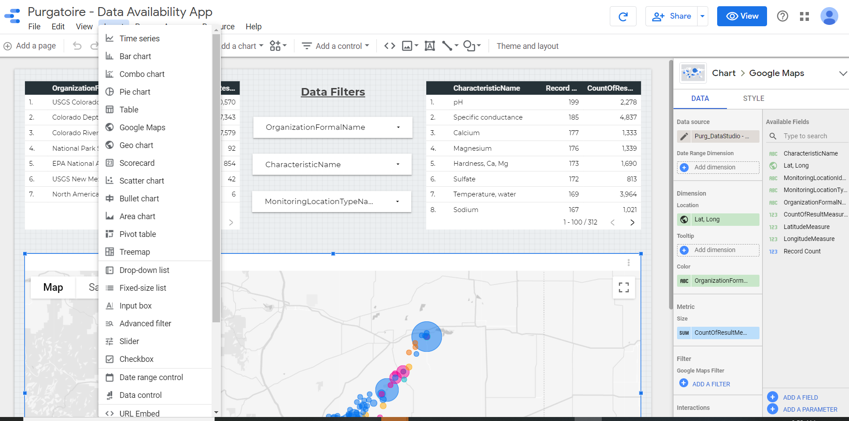
Step 2: Build a Report

Slide 9
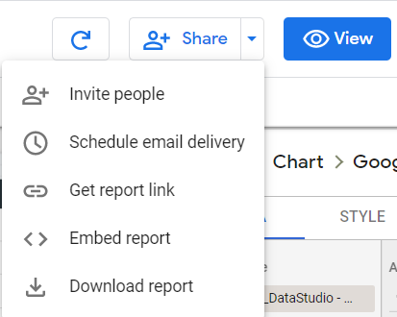
Step 3: Publish your Report
Get a link to a stand-alone page
Easily embed the live report in your website
Build custom viewers for boards or funders
Schedule email delivery

Slide 10
Let’s see how it works!
Here’s a link to a dataset: I will paste this in the Zoom chat box. Feel free to follow along or just watch the demo
https://docs.google.com/spreadsheets/d/1yOvqRbYa9iVLa0R-qaZI9e9xXjL6z-n_AYH8v-RGEJU/edit#gid=0

